Slide 1

Data55:
Richard, Anneke, Brendan,
Sara, Brenton, Saini and Aditya

Slide 2
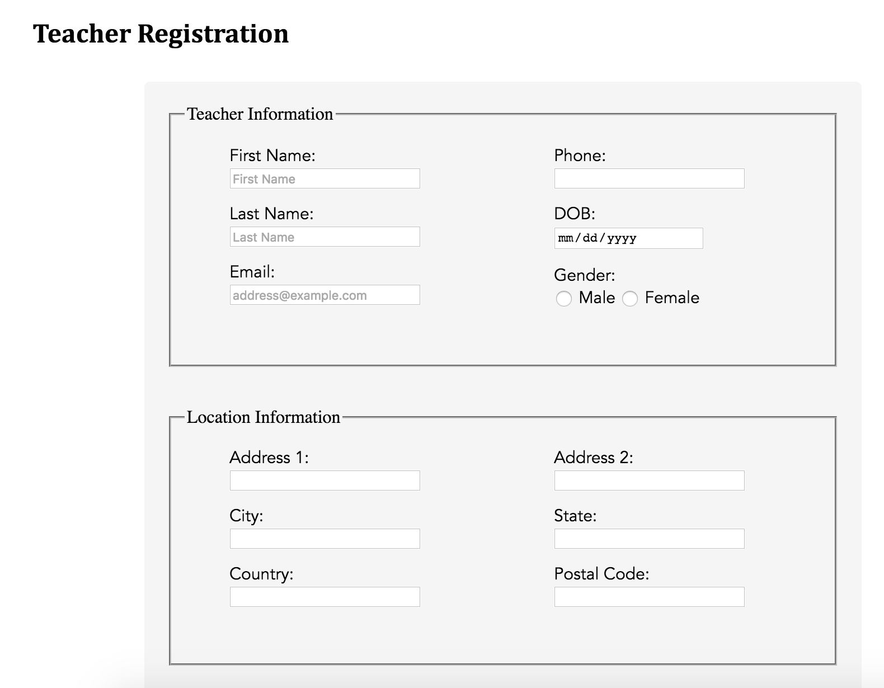
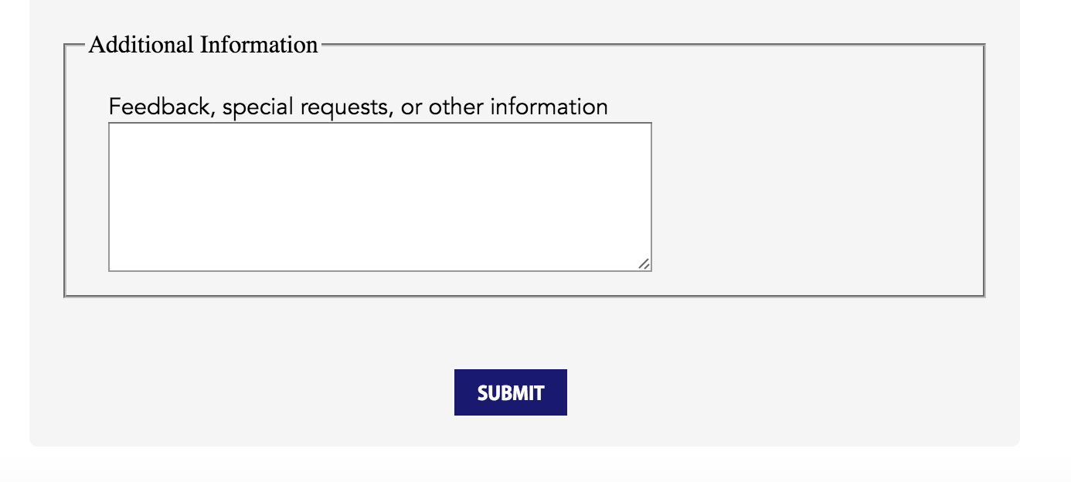
Stories: Teacher Registration (AALV-27)

Slide 3
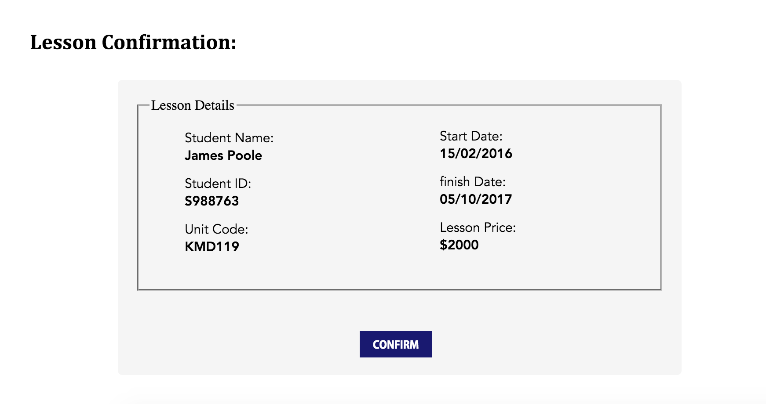
Stories: Student Lesson Application (AALV-11)

Slide 4
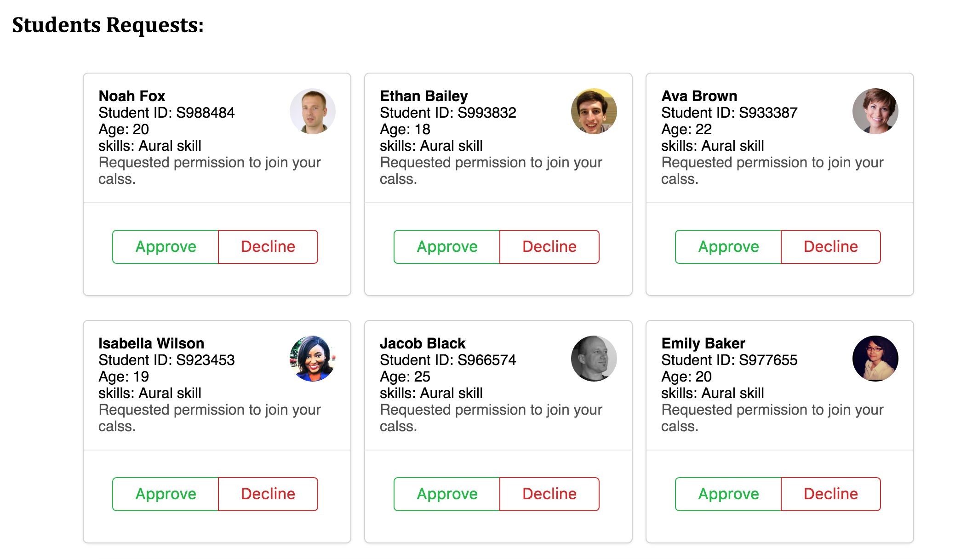
Stories: Teacher Accept Student (AALV-61)

Slide 5
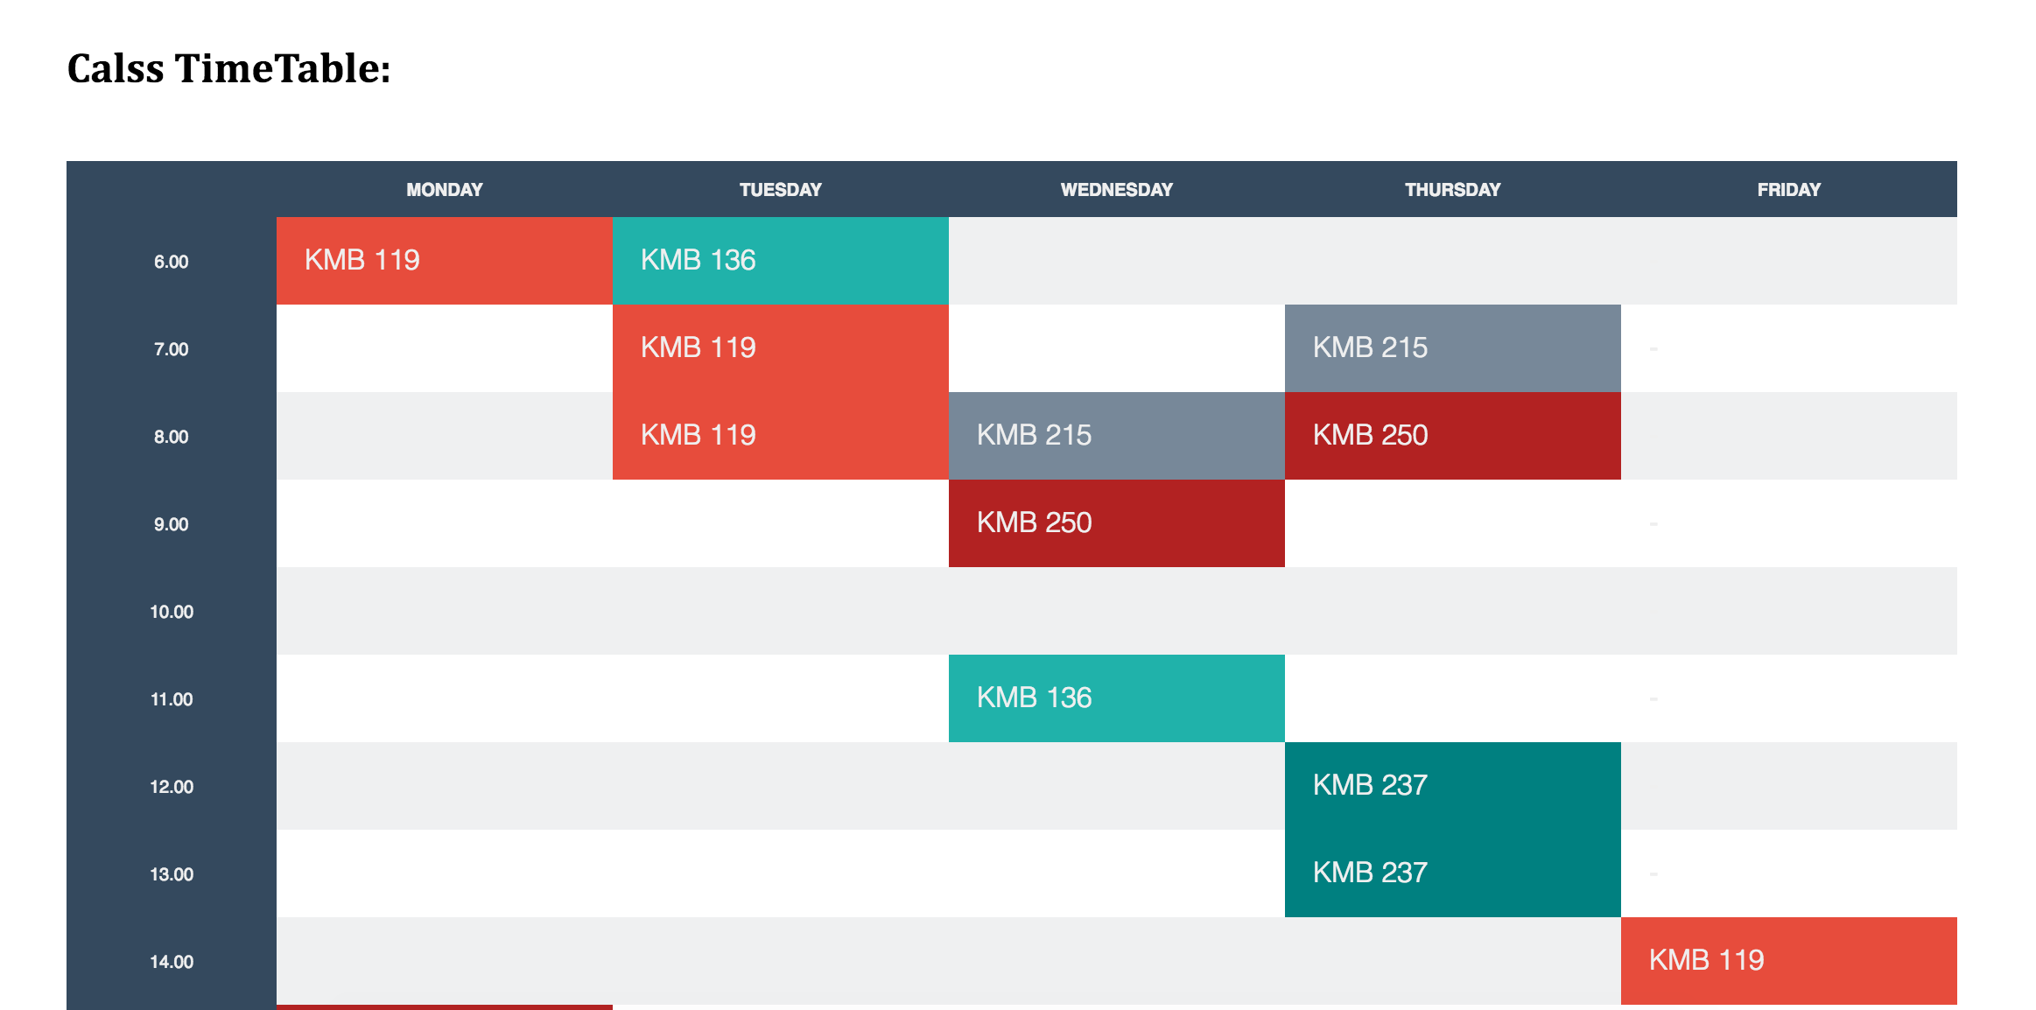
Stories: Student Get Lesson Info (AALV-58)

Slide 6
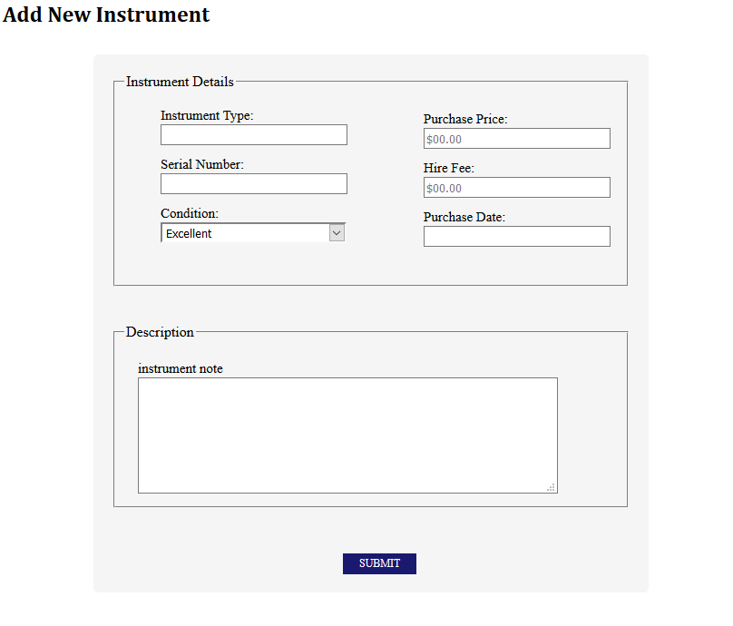
Stories: Add New Instruments (AALV-37)

Slide 7
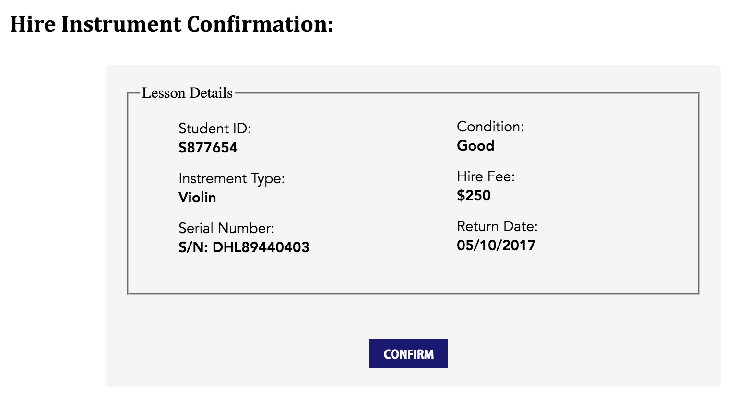
Stories: Hire Instruments (AALV-14)

Slide 8
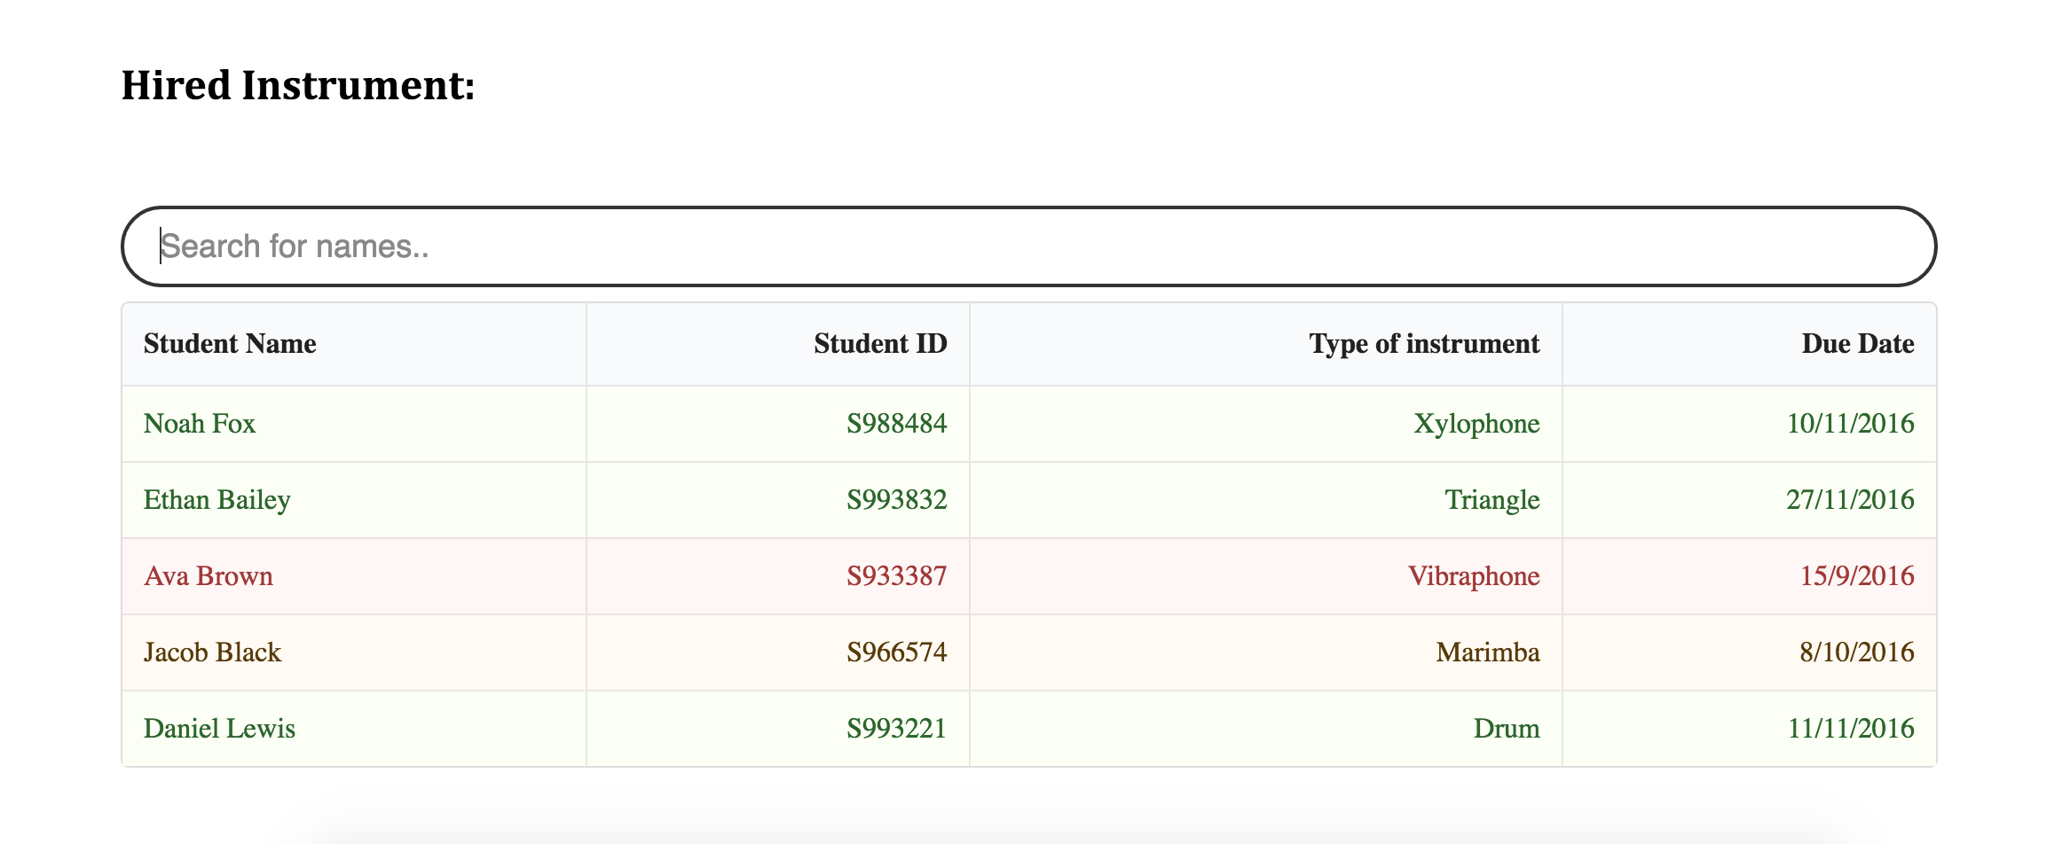
Stories: Return Instruments (AALV-35)

Slide 9
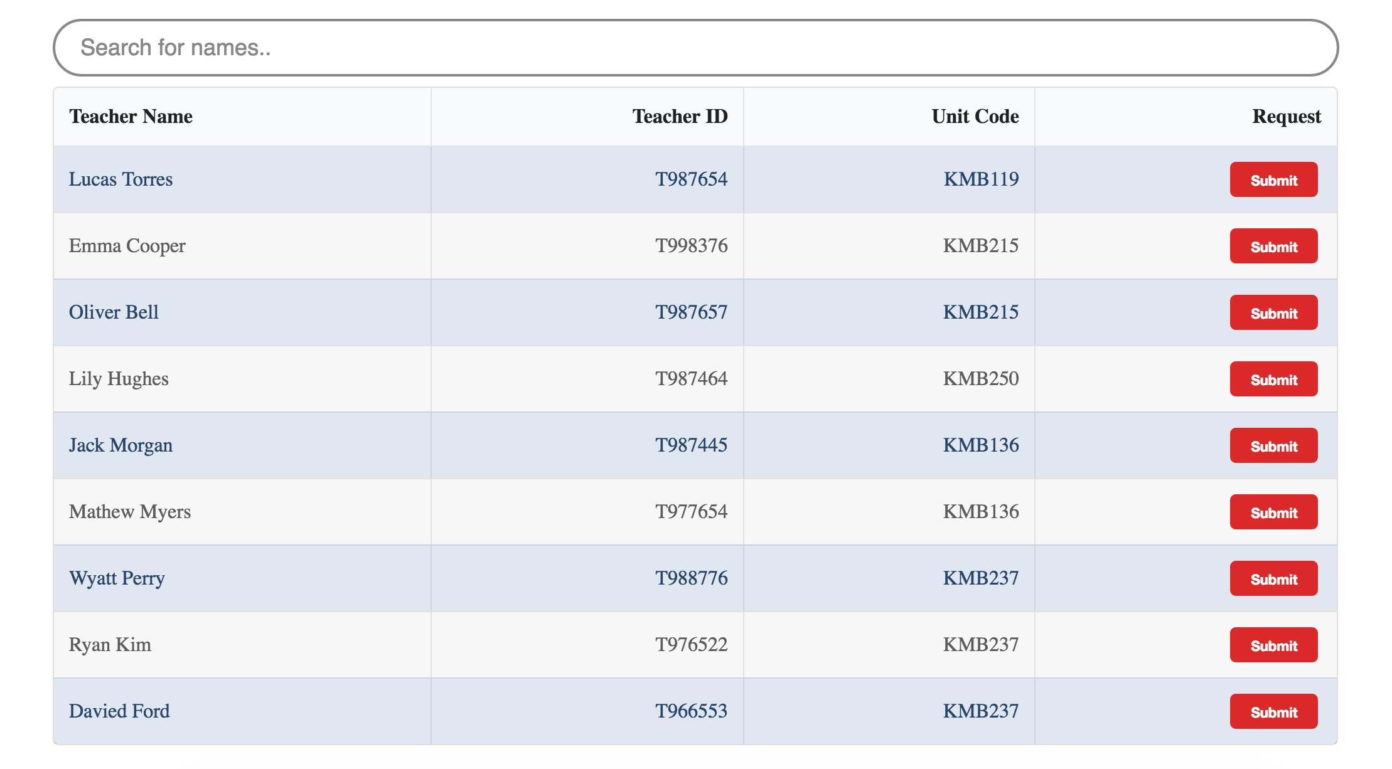
Stories: Request Specific Teacher (AALV-12)

